Slide 1
Categorization of Batches among Aspirants , Performer and Front Runner
Monitoring Parameters :-
1. Observation- Classroom Setup
2. Observation- Center Management
3. Observation- Beneficiary Related /Learner's Kit
4. Learner's Attendance
5. Learner's Assessment
6. Content Running Status
7. Center operating days
8. Retention of LOs

Slide 3
Batch Categorization Logic
Category | Marks | %
Aspirants | Less than 4 | Less than 70%
Performer | >=4 and <8 | >=70% and <80%
Front Runner | >=8 | >=80%

Slide 4
Division Logic
1. Observation- Classroom Setup
2. Observation- Center Management
1.1 Are all the equipment functional during the visit?
1.2 Are laptop and projector charged during the visits?
1.3 Is screen projection appropriate in the classroom?
1.4 Is seating arrangement proper at the center?
4
4
3
1
2.1 Is operational kit (Attendance, Assessment format, Teaching Plan etc) available at the batch? (As per the requirement of today's class)
2.2 Are all the documents updated along with the teaching plan?
2.3 Is the volunteer able to replicate the training instruction provide while teaching at the batch?
2.4 Is volunteer able to manage the class?
4
2
2
4
3. Observation- Beneficiary Related /Learner's Kit
4. Learner's Attendance
3.1.1 SHIKSHA Plus Text Book
3.1.2 Note Book
3.1.3 Pencil
3.1.4.Eraser
3.1.5 Sharpner
3.1.6 Slate
3.1.7 Chalk
3.1.8 Workbook
3.1.9 Jutebag
2
2
2
1
1
1
1
1
1
4.1 Learners average attendance Less Than 70%
4.1 Learners average attendance >= 70% and <80%
4.1 Learners average attendance greater Than 80%
4
8
12
Note :- Total marks - 12

Slide 5
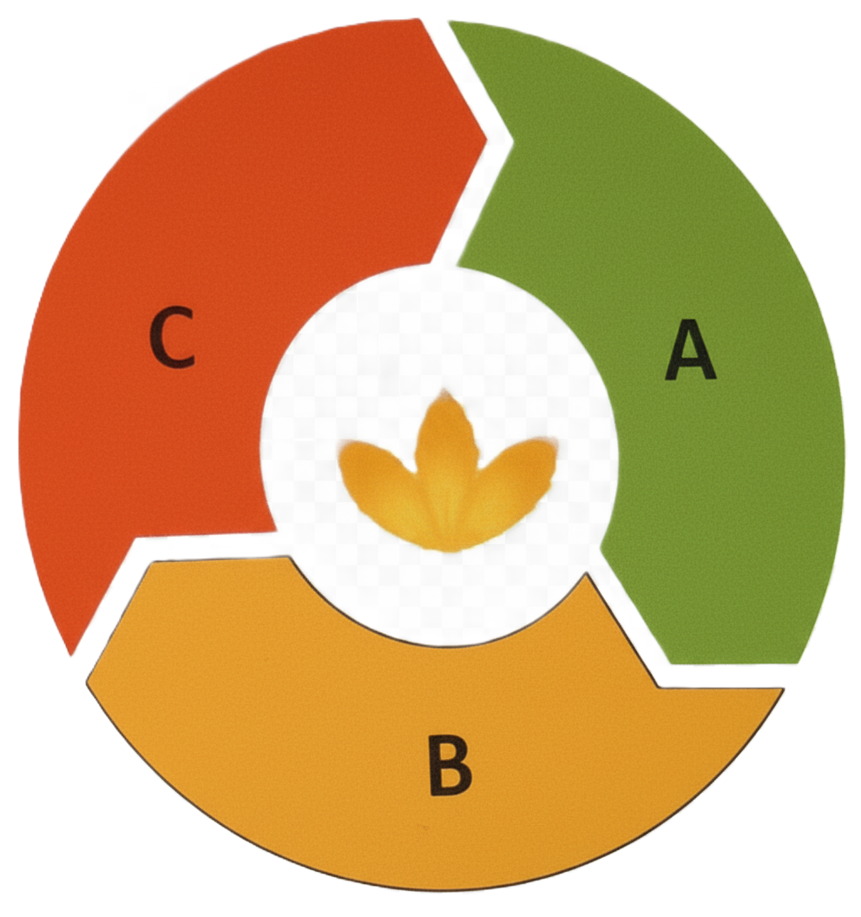
6. Content Running Status
🟥 Aspirant
In Ass. Cycle 2 - Content delivery through CMS is less than 11 days.
In Ass. Cycle 3 - Content delivery through CMS is less than 12 days.
In Ass. Cycle 4 - Content delivery through CMS is less than 11 days.
In Ass. Cycle 5 - Content delivery through CMS is less than 12 days.
In Ass. Cycle 6 - Content delivery through CMS is less than 9 days.
🟩 Front runner
In Ass. Cycle 2 - Content delivery through CMS is Minimum 14 days.
In Ass. Cycle 3 - Content delivery through CMS is Minimum 15 days.
In Ass. Cycle 4 - Content delivery through CMS is Minimum 14 days.
In Ass. Cycle 5 - Content delivery through CMS is Minimum 15 days.
In Ass. Cycle 6 - Content delivery through CMS is Minimum 12 days.
🟨 Performer
In Ass. Cycle 2 - Content delivery through CMS is Minimum 11 days.
In Ass. Cycle 3 - Content delivery through CMS is Minimum 10 days.
In Ass. Cycle 4 - Content delivery through CMS is Minimum 11 days.
In Ass. Cycle 5 - Content delivery through CMS is Minimum 12 days.
In Ass. Cycle 6 - Content delivery through CMS is Minimum 9 days.

Slide 6
5. Centre operating days
🟥 Aspirant
In Ass. Cycle 2 - ≤ 22 days.
In Ass. Cycle 3 - ≤ 27 days.
In Ass. Cycle 4 - ≤ 25 days.
In Ass. Cycle 5 - ≤ 27 days.
In Ass. Cycle 6 - ≤ 22 days.
🟩 Front runner
In Ass. Cycle 2 - 17-19 days.
In Ass. Cycle 3 - 21-23 days.
In Ass. Cycle 4 - 22-23 days.
In Ass. Cycle 5 - 22-23 days.
In Ass. Cycle 6 - 17-19 days.
🟨 Performer
In Ass. Cycle 2 - 20-21 days.
In Ass. Cycle 3 - 24-26 days.
In Ass. Cycle 4 - 23-24 days.
In Ass. Cycle 5 - 24-26 days.
In Ass. Cycle 6 - 20-21 days.

Slide 7
Division Logic
7. Learner's Assessment
8. Retention of LOs
4.1 Learners average assessment score Less Than 70%
4.1 Learners average assessment score >= 70% and <80%
4.1 Learners average assessment score greater Than 80%
4
8
12
8.1.1 Reading
8.1.2 Writing
8.1.3 Arithmetic
4
4
4

Slide 8
THANK
YOU

